Slide 1
Machine Learning
&
Neural Networks

Slide 2
Introduction to
Machine Learning
UNIT-1

Slide 3
Human learning
Learning is typically referred to as the process of Gaining Information through Observation.
For example, with more knowledge, the ability to do homework with less number of mistakes increases.
In the same way, information from past rocket launches helps in taking the right precautions and makes more successful rocket launch.
Thus, with more learning, tasks can be performed more efficiently.

Slide 4
Types of Human Learning
Learning under expert guidance
-Either somebody who is an expert in the subject directly teaches us
2. Learning guided by knowledge gained from experts
-We build our own notion indirectly based on what we have learnt from the expert in the past
-There is no direct learning. It is some past information shared on some different context, which is used as a learning to make decisions.
3. Learning by self
-We do it ourselves, may be after multiple attempts, some being unsuccessful.
-Humans are left to learn on their own

Slide 5
WHAT IS MACHINE LEARNING?
According to Tom M.Mitchell…
-A computer program is said to learn from experience E with respect to some class of tasks T and performance measure P, if its performance at tasks in T, as measured by P, improves with experience E.
A machine can be considered to learn if it is able to learn from experience (past data) by doing a certain task and improve its performance in doing the similar tasks in the future.
Example: Prediction of a person belongs to obesity category or not
E represents the past data having labels or assigned classes (for example whether the person of a class obesity or not), T is the task of assigning class or label to new data and P is the performance measure indicated by the percentage of obesity people correctly classified.

Slide 6
WHAT IS MACHINE LEARNING?
A subset of Artificial intelligence known as machine learning focuses primarily on the creation of model that enable a computer to independently learn from data and previous experiences to make predictions
    or
                Machine Learning is a branch of Artificial intelligence that develops models by learning the hidden patterns of the datasets used it to make predictions on new similar type data, without being explicitly programmed for each task.
                or
                Machine learning is a subfield of Artificial intelligence that uses algorithms trained on data sets to create models that enable machines to perform tasks that would otherwise only be possible for humans, such as categorizing images, analyzing data, or predicting price fluctuations.
                or
                A “Field of study that gives computers the capability to learn without being explicitly programmed”.

Slide 7
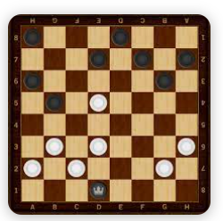
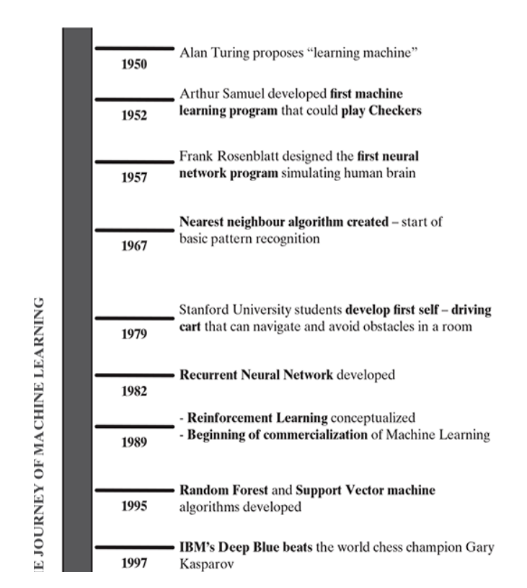
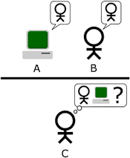
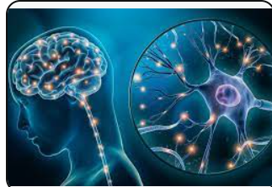
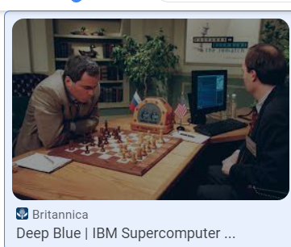
Evolution or History of machine learning

Slide 8
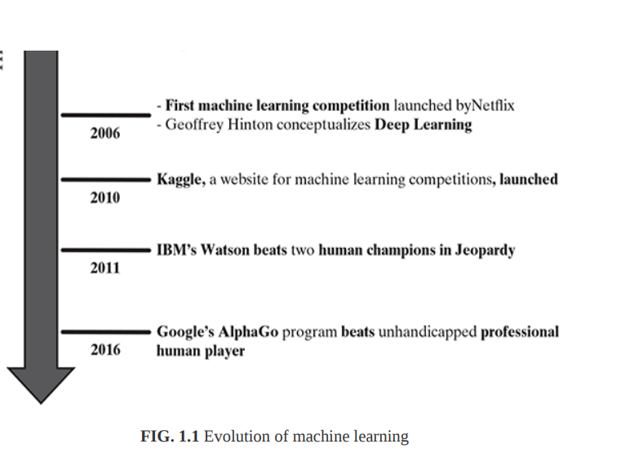
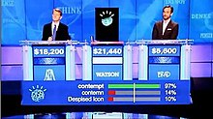
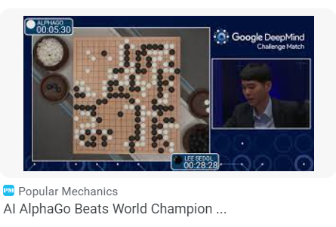
Evolution of machine learning (Continue..)

Slide 9
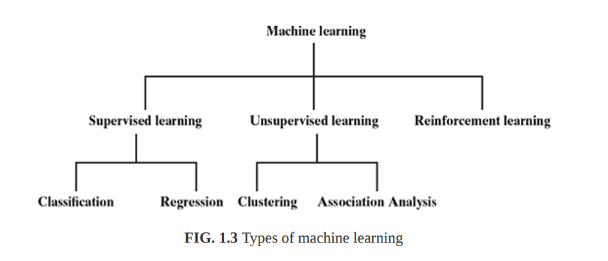
Types of machine Learning
Supervised Learning
2. Unsupervised Learning
3. Reinforcement Learning

Slide 10
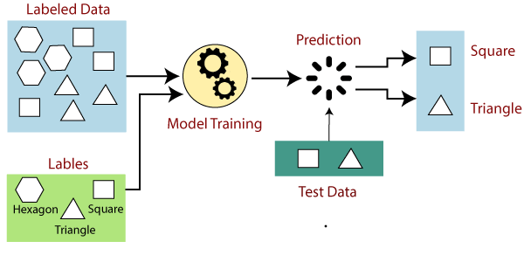
Supervised Learning
Supervised learning is a machine learning method in which models are trained using labeled data.
In supervised learning technique, we train the machines using the "labelled" dataset, and based on the training, the machine predicts the output.
Here, the labelled data specifies that some of the inputs are already mapped to the output. More preciously, we can say; first, we train the machine with the input and corresponding output (train dataset) , and then we ask the machine to predict the output using the test dataset.

Slide 11
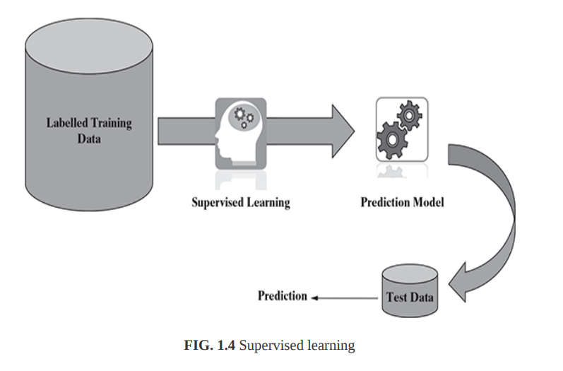
Supervised Learning
Some examples of supervised learning are :
Predicting the results of a game
Predicting whether a tumour is malignant or benign
Predicting the price of domains like real estate, stocks, etc.
Classifying texts such as classifying a set of emails as spam or non-spam

Slide 12
Supervised Learning Algorithms
Classification
Classification is a supervised machine learning method where the model tries to predict the correct label of a given input data. In classification, the model is fully trained using the training data, and then it is evaluated on test data before being used to perform prediction on new unseen data.

Slide 13
Supervised Learning Algorithms
2. Regression
Regression is a method for understanding the relationship between independent variables or features and a dependent variable or outcome.
  Linear Regression
In Linear regression, the objective is to predict numerical features like real estate or stock price, temperature, marks in an examination, sales revenue, etc. The underlying predictor variable and the target variable are continuous in nature.
  Logistic Regression
  Logistic regression predicts the output of a categorical dependent variable. Therefore the outcome must be a categorical or discrete value. It can be either Yes or No, 0 or 1, true or False, etc. but instead of giving the exact value as 0 and 1, it gives the probabilistic values which lie between 0 and 1.

Slide 14
Supervised Learning Algorithms
Typical applications of regression can be seen in..
Sales prediction for managers
Price prediction in real estate
Weather forecast
Skill demand forecast in job market
Demand forecasting in retails

Slide 15
Unsupervised Learning
Unlike supervised learning, in unsupervised learning, there is no labelled training data to learn from and no prediction to be made.
In unsupervised learning, the models are trained with the data that is neither classified nor labelled, and the model acts on that data without any supervision.
The main aim of the unsupervised learning algorithm is to group or categories the unsorted dataset according to the similarities, patterns, and differences. Machines are instructed to find the
hidden patterns from the input dataset.
Clustering
Association Analysis

Slide 16
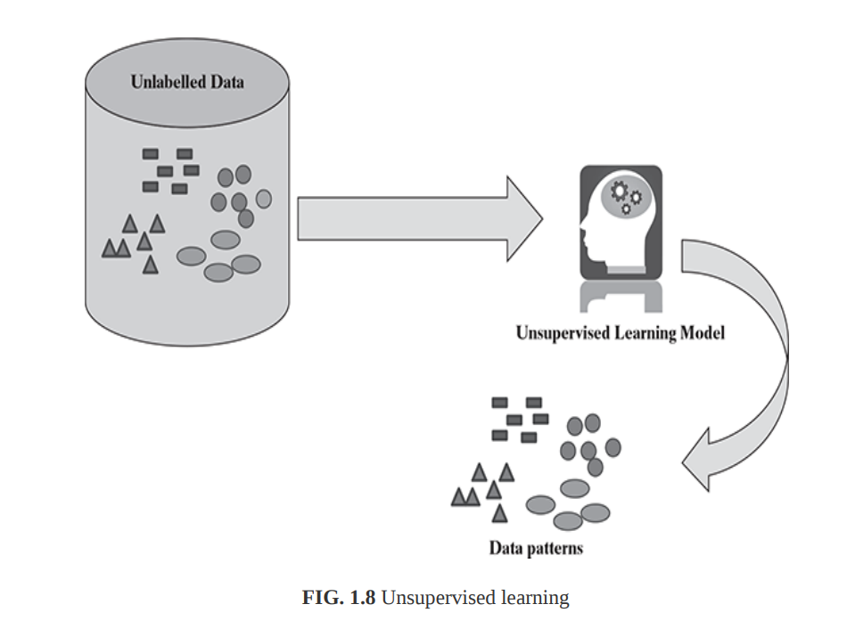
Unsupervised Learning Algorithms

Slide 17
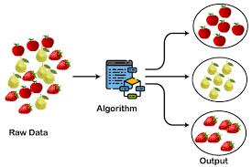
Unsupervised Learning Algorithms
Clustering
Clustering is the main type of unsupervised learning.
It intends to group or organize similar objects or data points together.
For that reason, objects belonging to the same cluster are quite similar to each other while objects belonging to different clusters are quite dissimilar

Slide 18
Unsupervised Learning Algorithms
2. Association Analysis
An Association Analysis or Association rule is an unsupervised learning method used to find relationships between different items in a dataset.
It determines the set of items that occurs together in the dataset. *
Association rule makes marketing strategy more effective.
Such as people who buy X item (suppose a bread) are also tend to purchase Y (Butter/Jam) item.
A typical example of Association rule is Market Basket Analysis.

Slide 19
Unsupervised Learning Algorithms
Hierarchical clustering
Density-Based Spatial Clustering of Applications with Noise (DBSCAN)
k-medoids

Slide 20
Reinforcement Learning
Reinforcement Learning is a feedback-based Machine learning technique in which an agent learns to behave in an environment by performing the actions and seeing the results of actions. For each good action, the agent gets positive feedback, and for each bad action, the agent gets negative feedback or penalty.
In Reinforcement Learning, the agent learns automatically using feedbacks without any labeled data, unlike supervised learning.
Or
Reinforcement learning (RL) is defined as a sub-field of machine learning that enables AI-based systems to take actions in a dynamic environment through trial and error methods to maximize the collective rewards based on the feedback generated for respective actions.

Slide 21
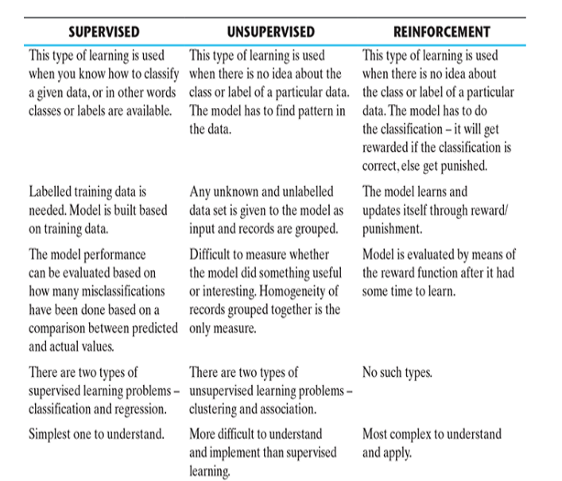
Comparison – supervised, unsupervised, and reinforcement learning

Slide 22
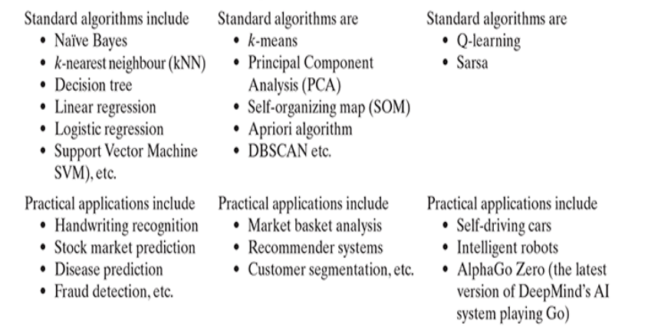

Slide 23
Problems Not To Be Solved Using Machine Learning
Machine learning should not be applied to tasks in which humans are very effective or frequent human intervention is needed.
For example, Air traffic control is a very complex task needing intense human involvement.
At the same time, for very simple tasks which can be implemented using traditional programming paradigms, there is no sense of using machine learning.
For example, simple rule-driven or formula-based applications like price calculator engine, dispute tracking application, etc. do not need machine learning techniques.

Slide 24
Problems Not To Be Solved Using Machine Learning
For situations where training data is not sufficient, machine learning cannot be used effectively.
This is because, with small training data sets, the impact of bad data is exponentially worse.
For the quality of prediction or recommendation to be good, the training data should be sizeable.

Slide 25
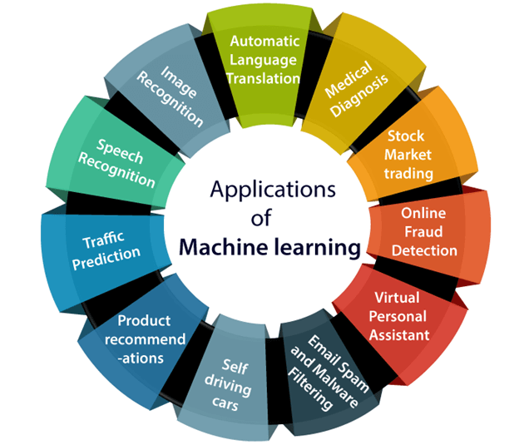
Applications of Machine Learning
Major Domains:
Banking and finance
Healthcare
Agriculture
Robotics
Social Media Analysis
Gaming
Insurance
Vision systems

Slide 26
Tools In Machine Learning
Python- Python is a high-level programming language , used to create a range of applications, including data science, software and web development, automation, and improving the ease of everyday tasks.
  NumPy- for mathematical functionalities
  -For fast operations on arrays, including mathematical, logical, shape manipulation, sorting, selecting, I/O, discrete Fourier transforms, basic linear algebra, basic statistical operations, random simulation and much more.
  SciPy- Algorithms and advanced mathematical tools
  - Provides algorithms for optimization, integration, interpolation, eigenvalue problems, algebraic equations, differential equations, statistics and many other classes of problems.
  matplotlib - Numerical plotting
  -Matplotlib is an amazing visualization library in Python for 2D plots of arrays. Matplotlib is a multi-platform data visualization library built on NumPy. Matplotlib consists of several plots like line, bar, scatter, histogram, etc.
  Scikit-learn or sklearn - A machine learning library, classification, regression, and clustering algorithms embedded in it.
R
-R is a language for statistical computing and data analysis. It is an open source language, extremely popular in the academic community – especially among statisticians and data miners.

Slide 27
Tools In Machine Learning
Matlab
MATLAB (matrix laboratory) is a licensed commercial software with a robust support for a wide range of numerical computing. MATLAB also provides extensive support of statistical functions and has a huge number of machine learning algorithms in-built. It also has the ability to scale up for large datasets by parallel processing on clusters and cloud.
SAS (earlier known as ‘Statistical Analysis System’)
is another licensed commercial software which provides strong support for machine learning functionalities.
IBM, SPSS (originally named as Statistical Package for the Social Sciences)
is a popular package supporting specialized data mining and statistical analysis. Originally popular for statistical analysis in social science (as the name reflects), SPSS is now popular in other fields as well.
Julia
is an open source, liberal license programming language for numerical analysis and computational science.
It has baked in all good things of MATLAB, Python, R, and other programming languages used for machine learning for which it is gaining steady attention from machine learning development community. Another big point in favor of Julia is its ability to implement high performance machine learning algorithms.

Slide 28
Issues In Machine Learning
Machine learning is a field which is relatively new and still evolving.
Also, the level of research and kind of use of machine learning tools and technologies varies drastically from country to country.
The biggest fear and issue arising out of machine learning is related to privacy and the breach of it.
The primary focus of learning is on analyzing data, both past and current, and coming up with insight from the data. This insight may be related to people and the facts revealed might be private enough to be kept confidential.
Even if there is no breach of privacy, there may be situations where actions were taken based on machine learning may create an adverse reaction.

Slide 29
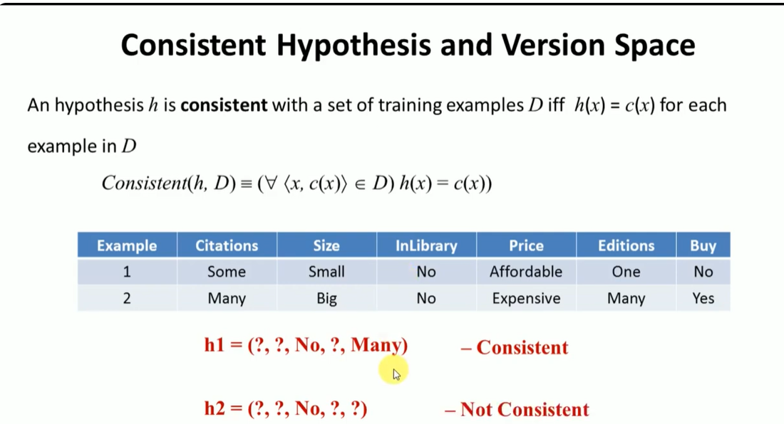
Version Space

Slide 30
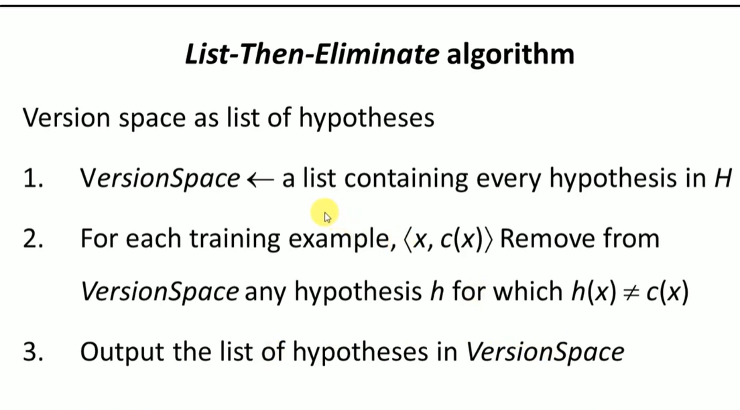
Version Space

Slide 31
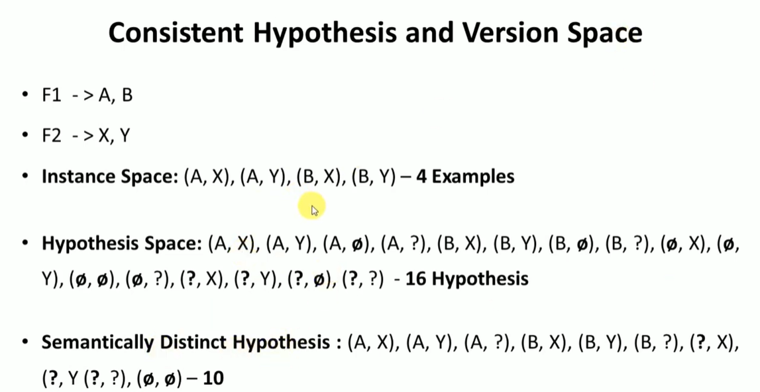
Version Space

Slide 32
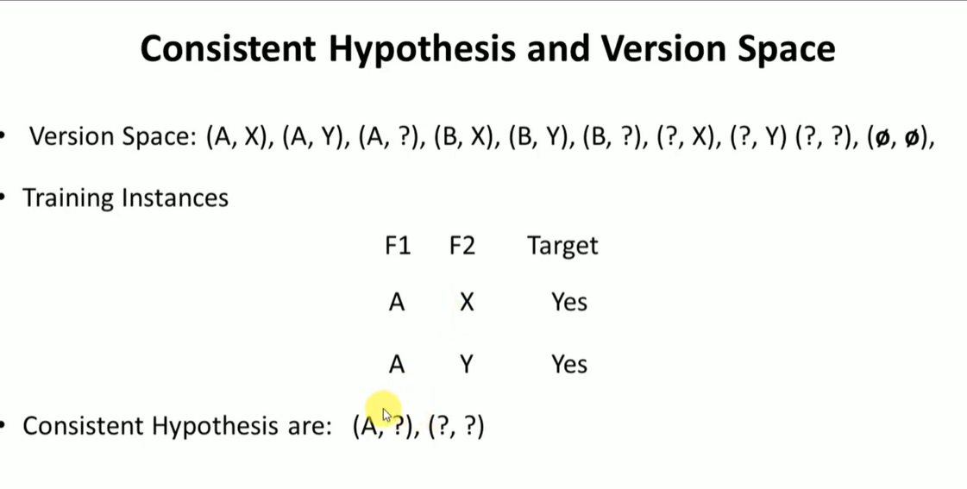
Version Space

Slide 33
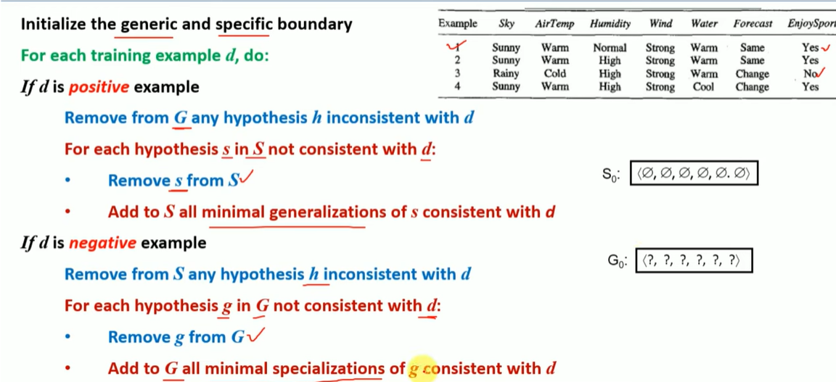
Candidate Elimination Algorithm

Slide 34
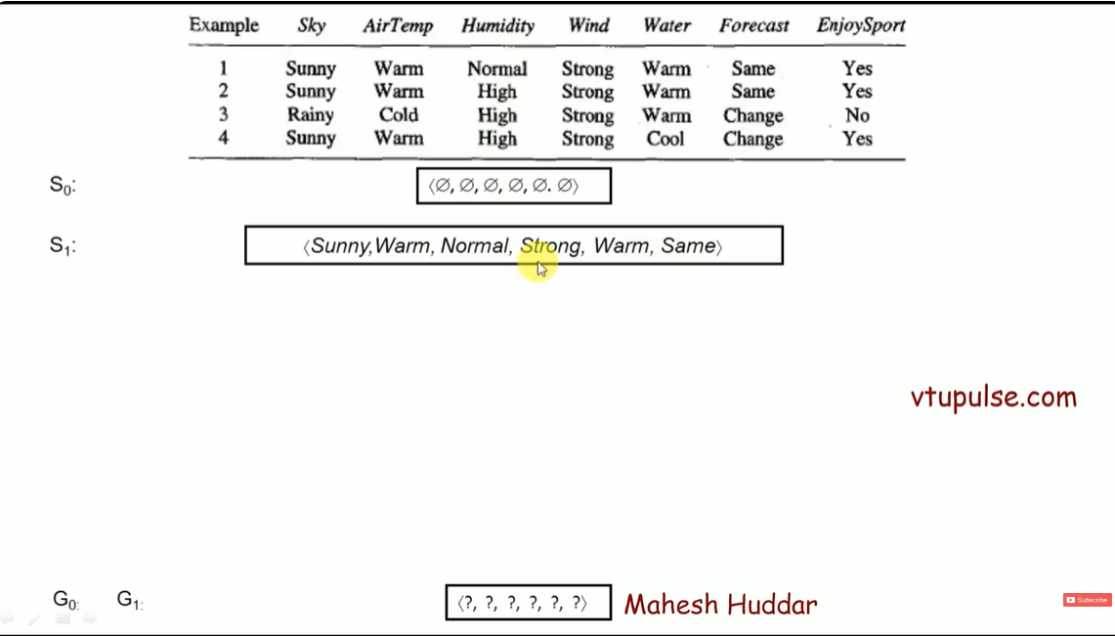
Candidate Elimination Algorithm

Slide 35
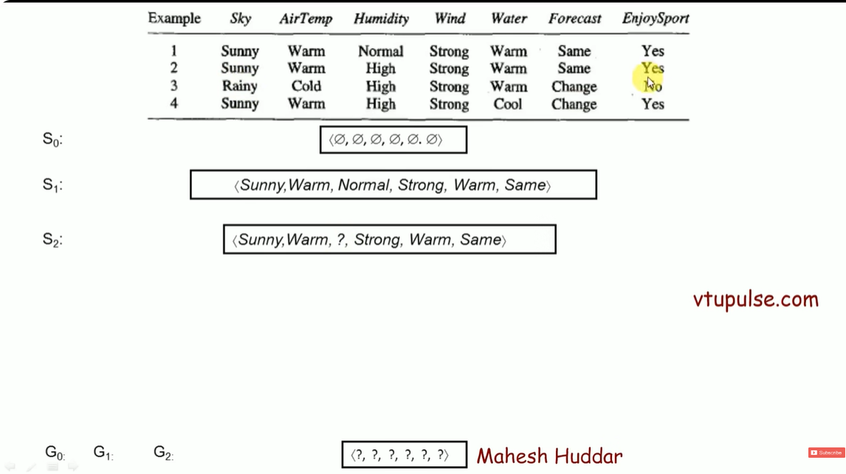
Candidate Elimination Algorithm

Slide 36
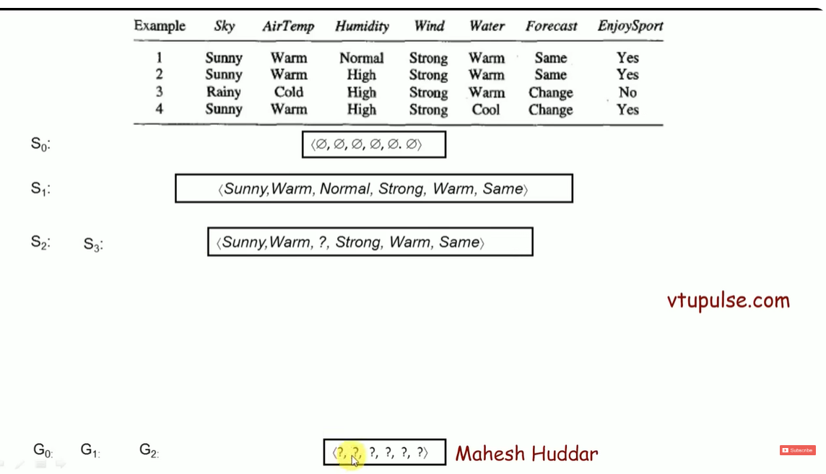
Candidate Elimination Algorithm

Slide 37
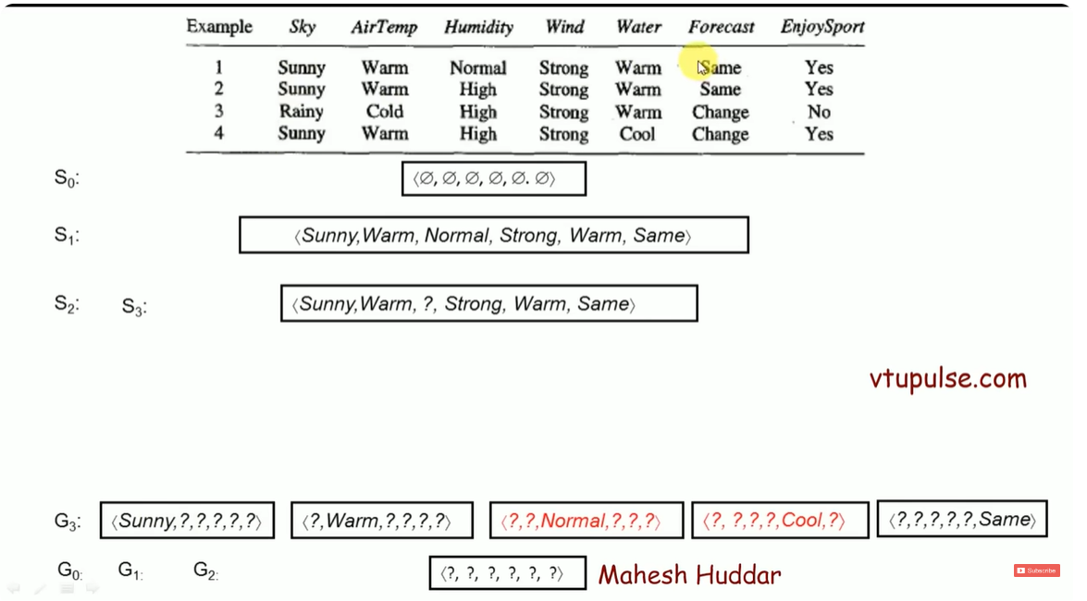
Candidate Elimination Algorithm

Slide 38
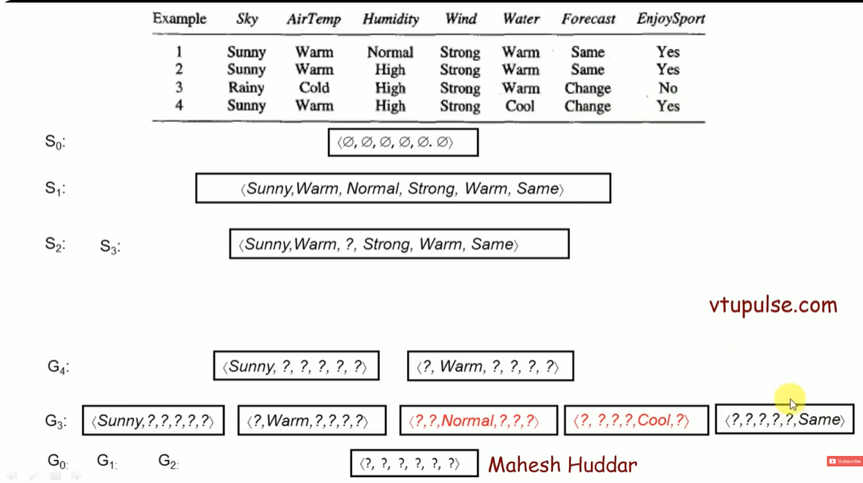
Candidate Elimination Algorithm

Slide 39
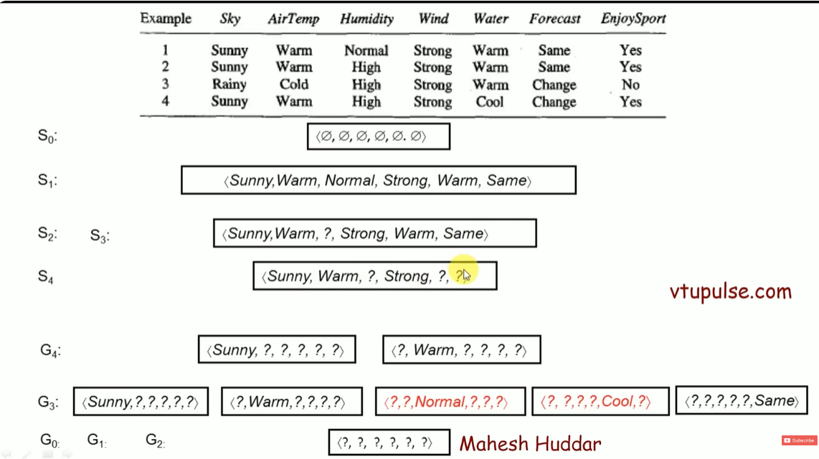
Candidate Elimination Algorithm

Slide 40
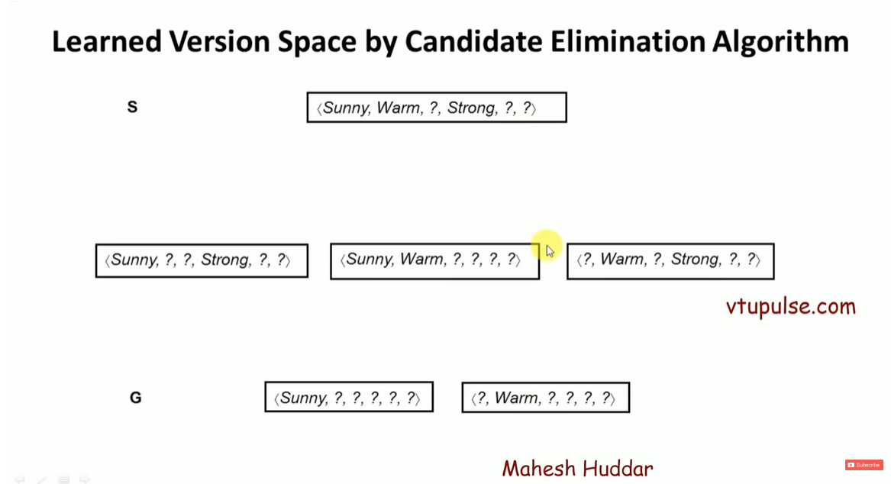
Candidate Elimination Algorithm

Slide 41
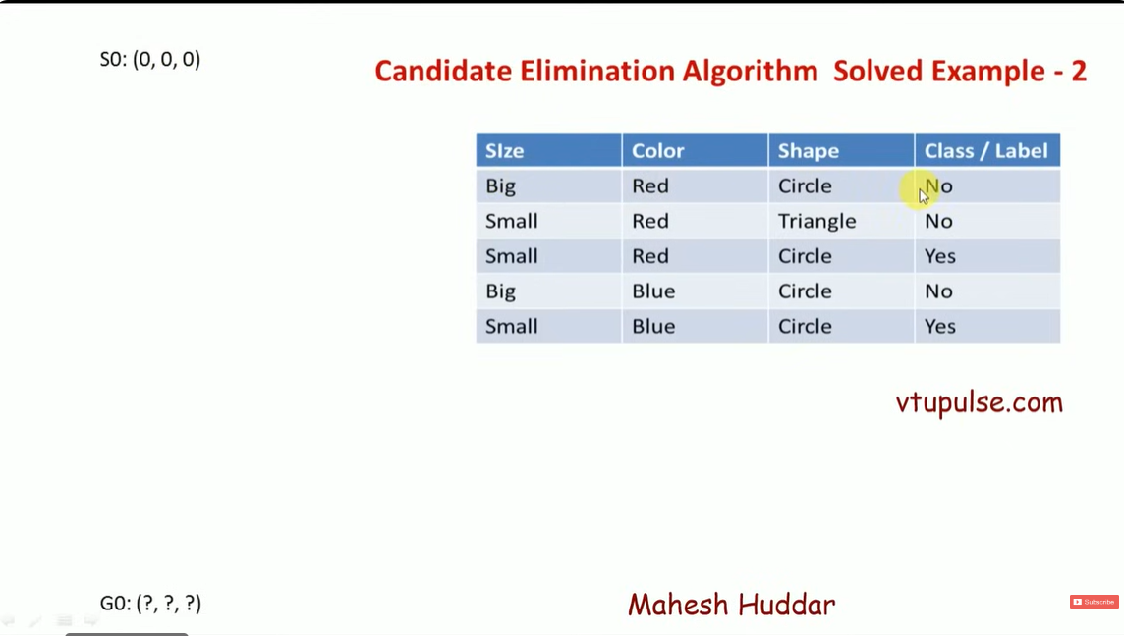
Candidate Elimination Algorithm

Slide 42
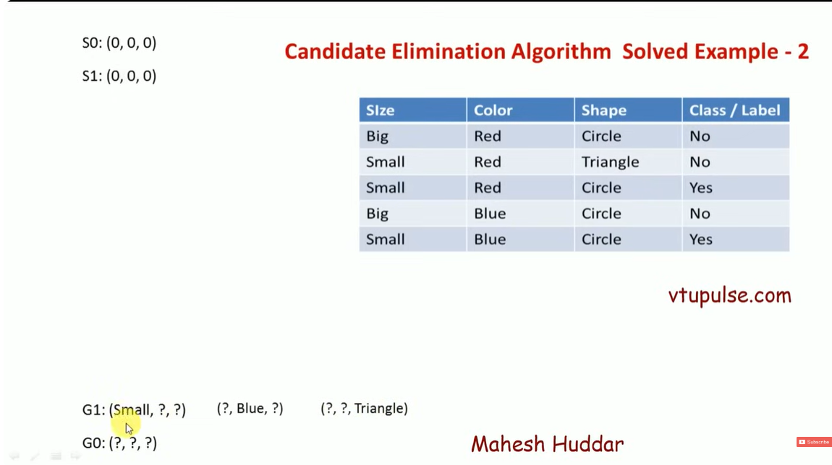
Candidate Elimination Algorithm

Slide 43
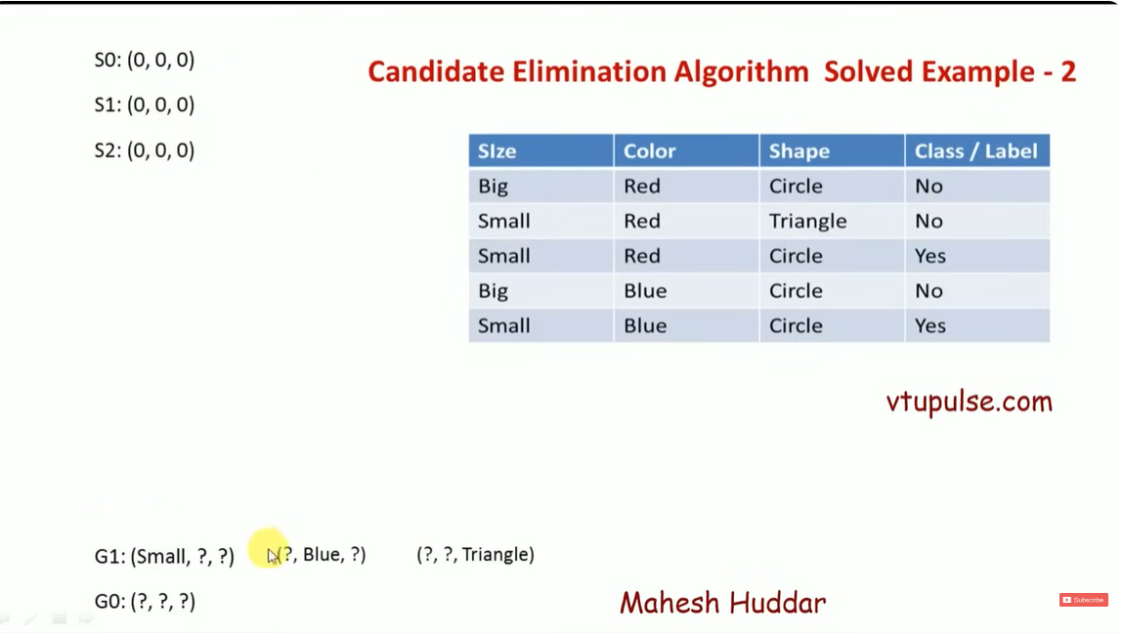
Candidate Elimination Algorithm

Slide 44
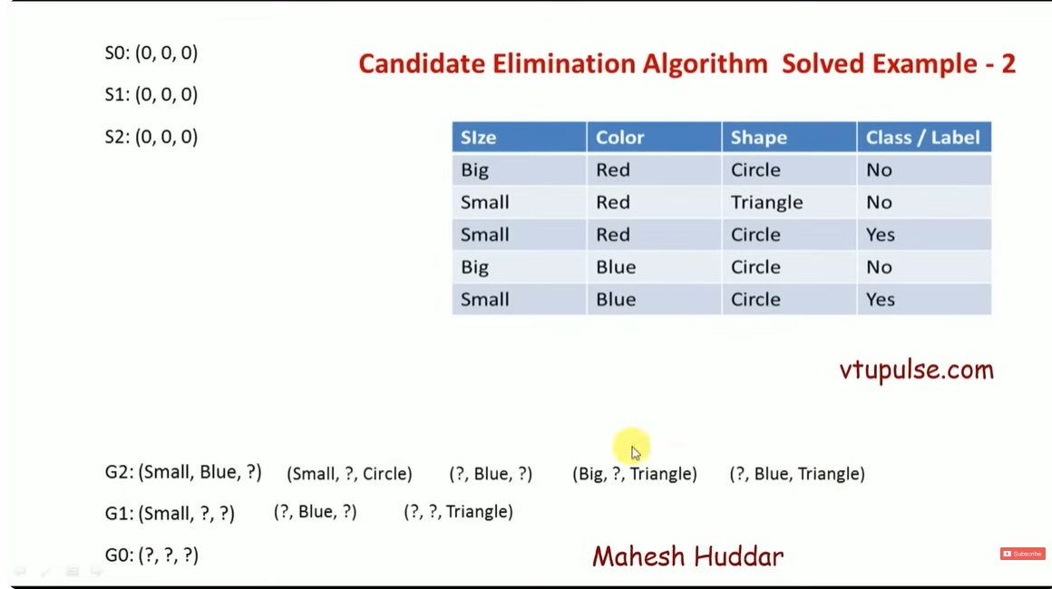
Candidate Elimination Algorithm

Slide 45
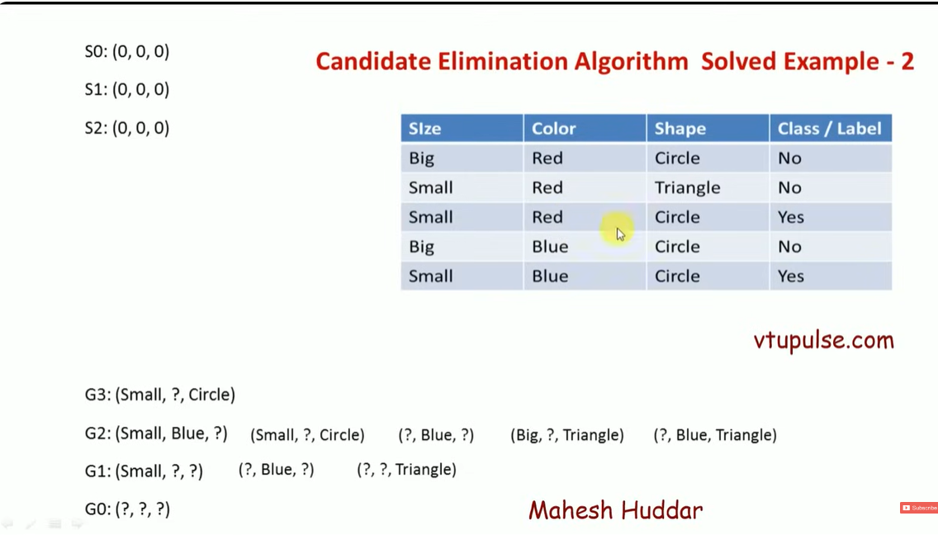
Candidate Elimination Algorithm

Slide 46
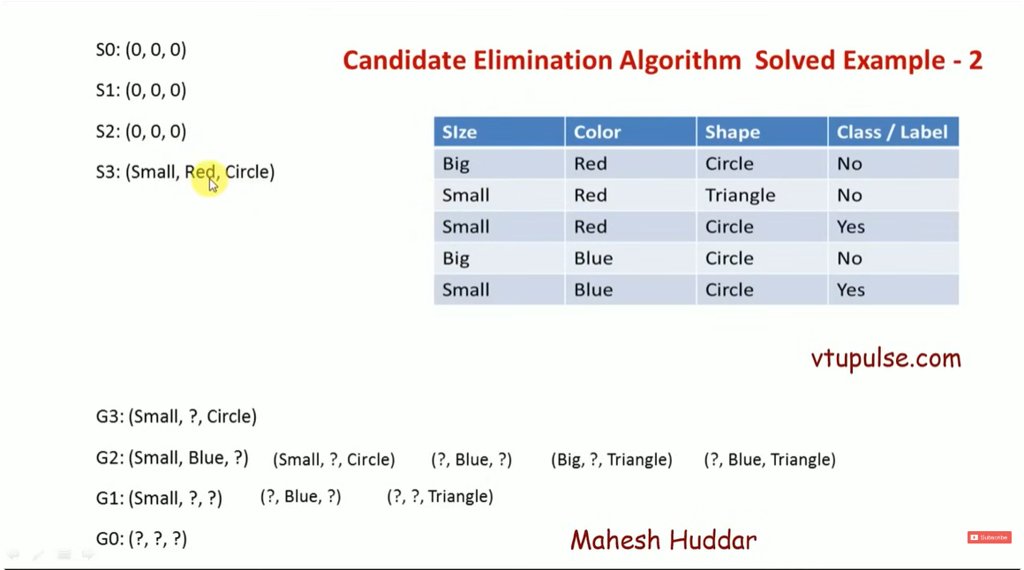
Candidate Elimination Algorithm

Slide 47
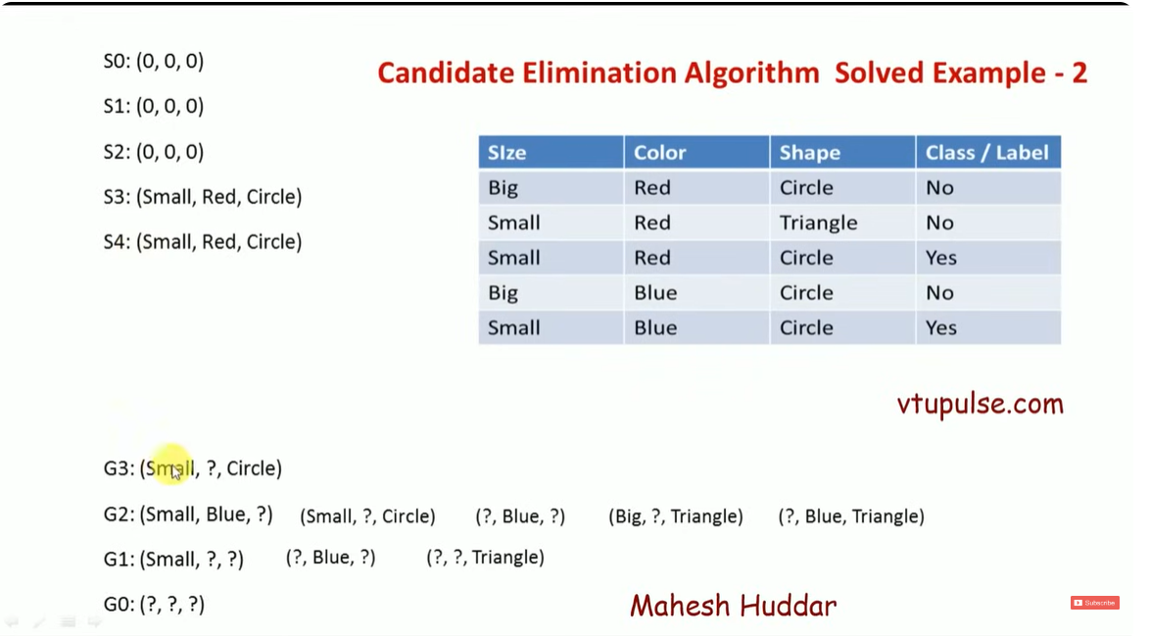
Candidate Elimination Algorithm

Slide 48
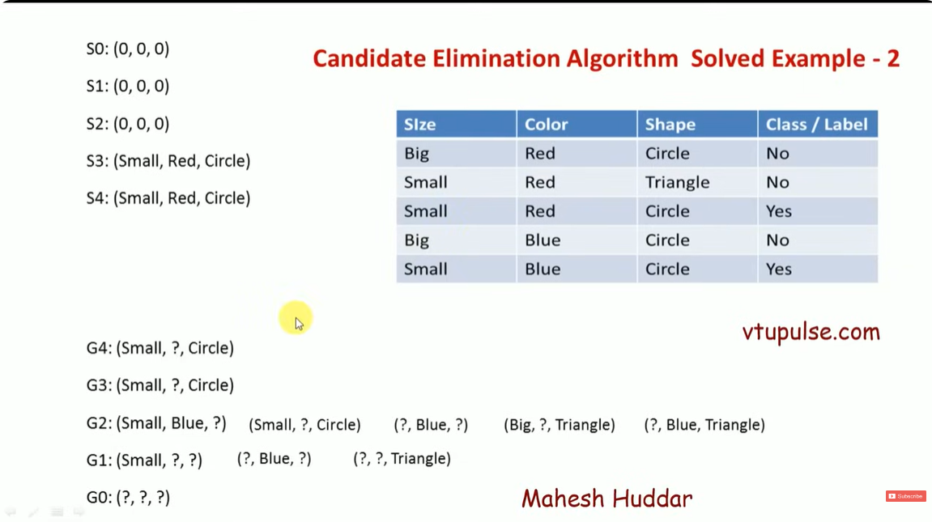
Candidate Elimination Algorithm

Slide 49
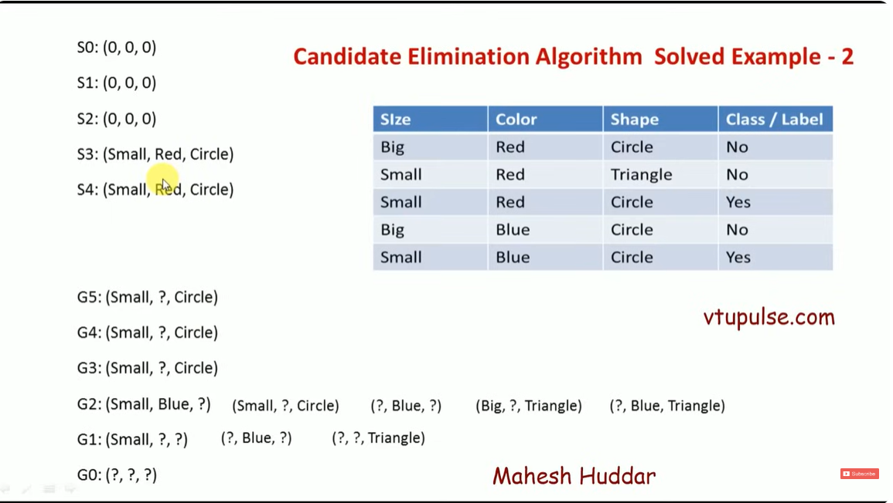
Candidate Elimination Algorithm

Slide 50
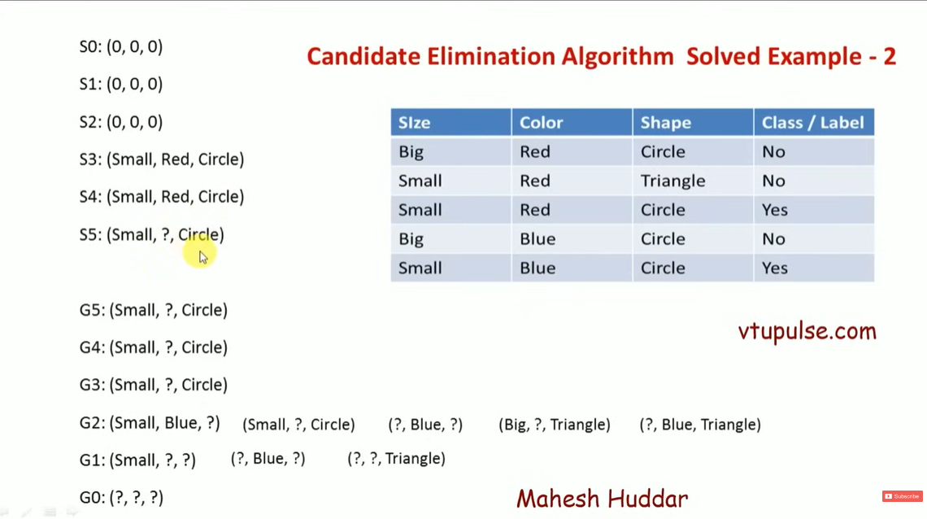
Candidate Elimination Algorithm

Slide 51
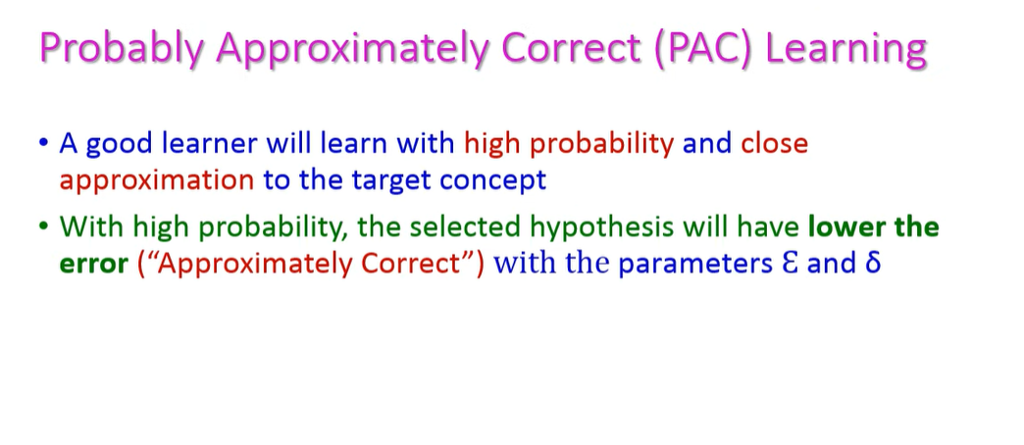
Probability Approximately Correct (PAC) Learning

Slide 52
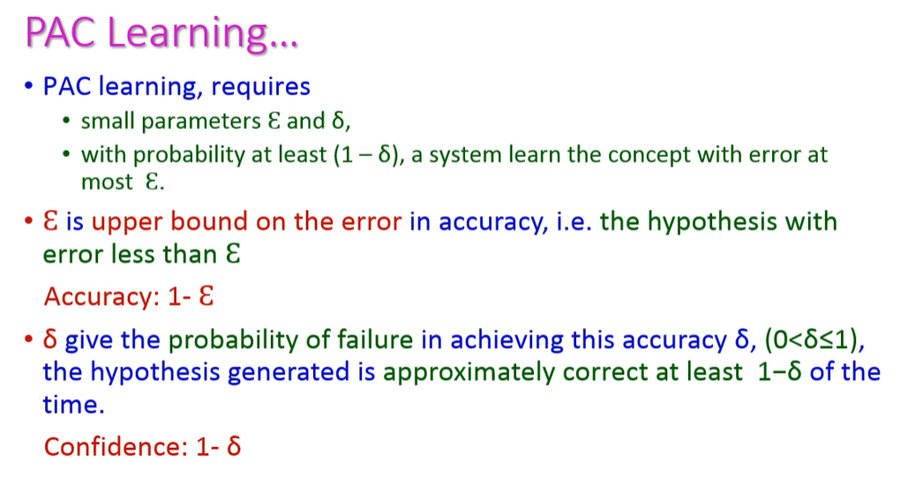
Probability Approximately Correct (PAC) Learning

Slide 53
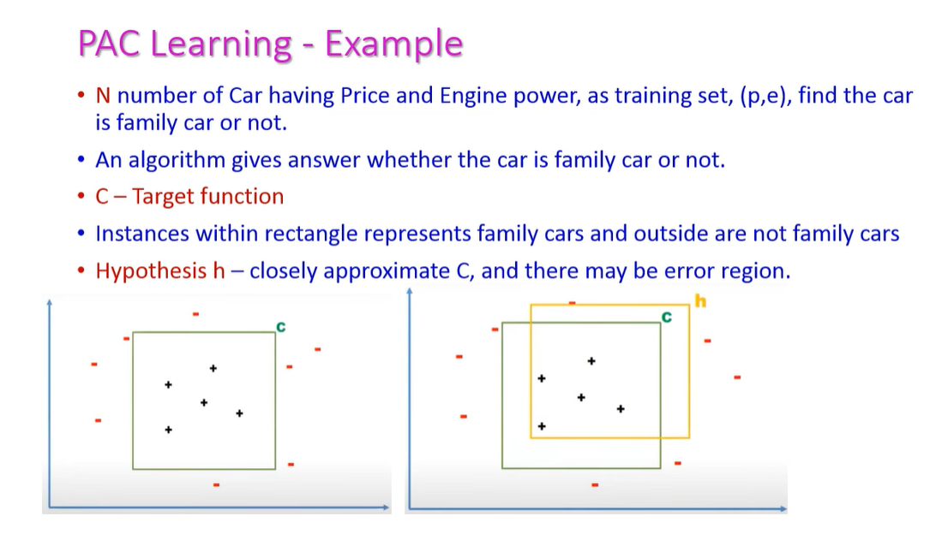
Probability Approximately Correct (PAC) Learning

Slide 54
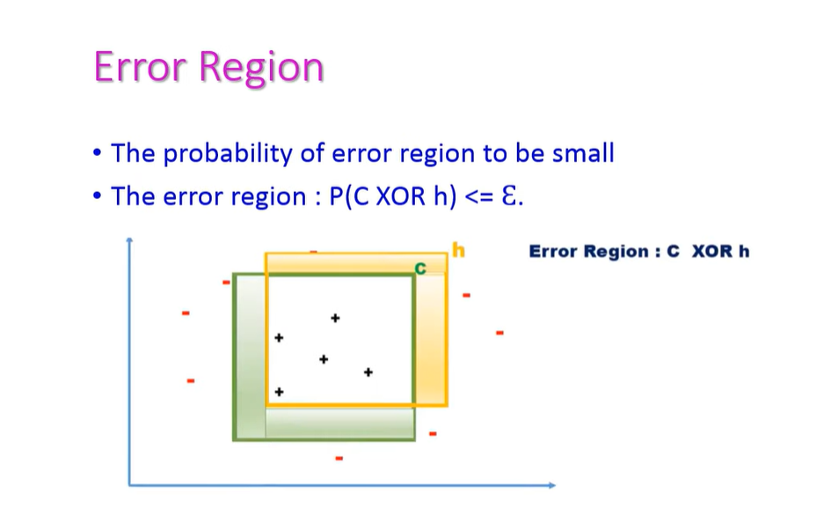
Probability Approximately Correct (PAC) Learning

Slide 55
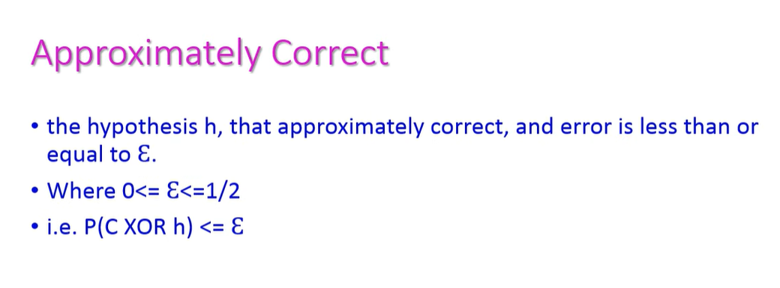
Probability Approximately Correct (PAC) Learning

Slide 56
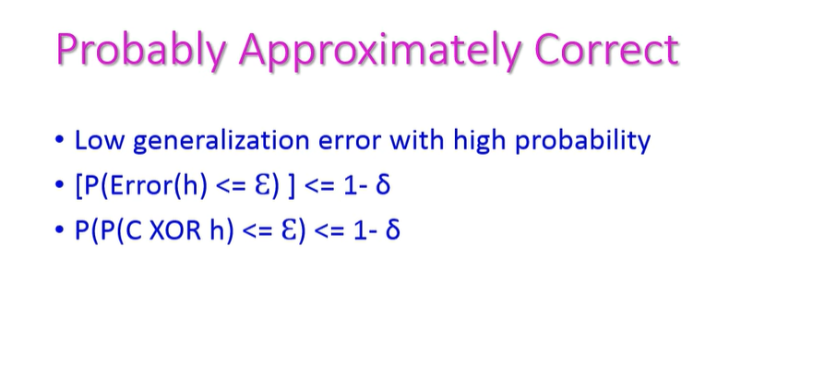
Probability Approximately Correct (PAC) Learning

Slide 57
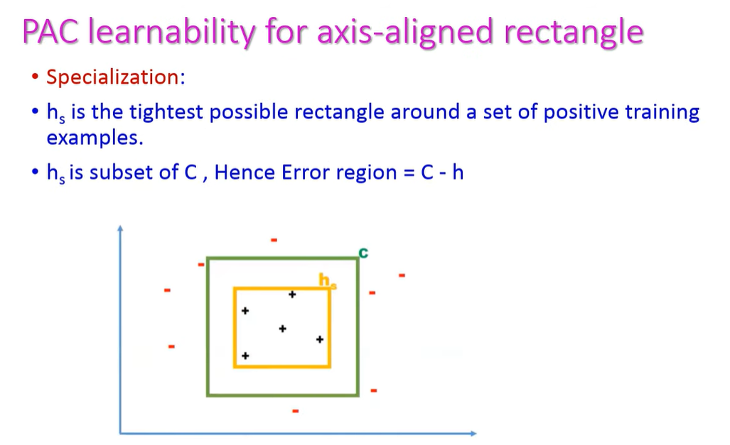
Probability Approximately Correct (PAC) Learning

Slide 58
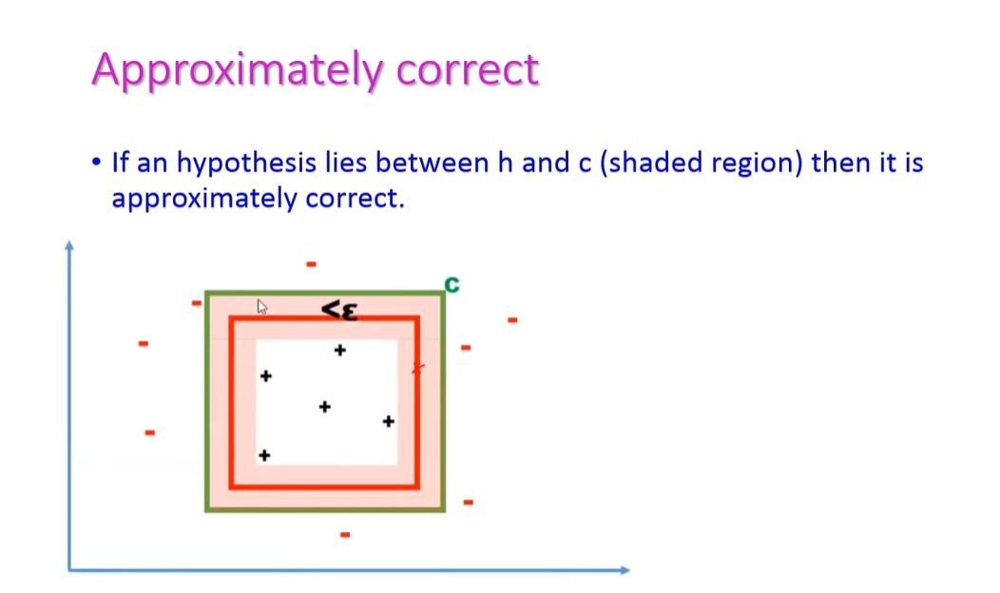
Probability Approximately Correct (PAC) Learning

Slide 59
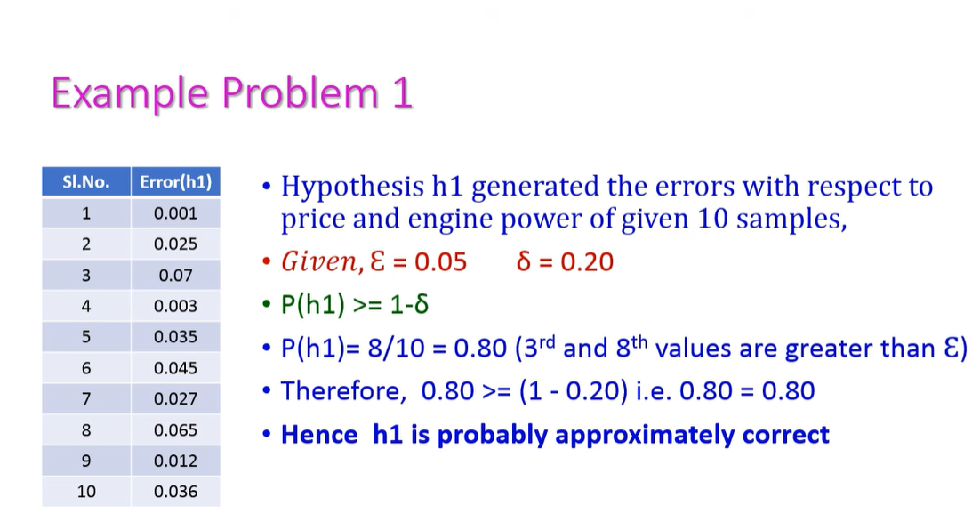
Probability Approximately Correct (PAC) Learning

Slide 60
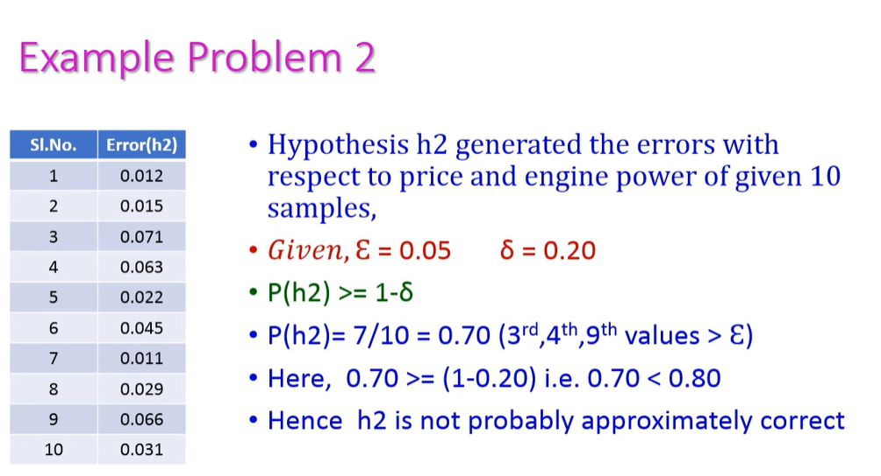
Probability Approximately Correct (PAC) Learning

Slide 61
Supervised Learning: Classification

Slide 62
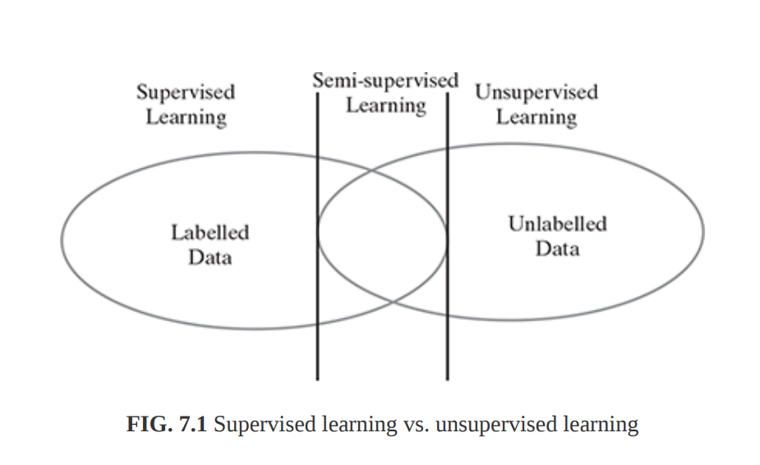
Examples Of Supervised Learning
In supervised learning, the labelled training data provide the basis for learning.
According to the definition of machine learning, this labelled training data is the experience or prior knowledge or belief.
Training data is the past information with known value of class field or ‘label’. Hence, we say that the ‘training data is labelled’ in the case of supervised learning.

Slide 63
Classification Model
Classification
Let us consider two examples, say ‘predicting whether a tumour is malignant or benign’ and ‘price prediction in the domain of real estate’.
Are these two problems same in nature?
When we are trying to predict a categorical or nominal variable, the problem is known as a classification problem.
Whereas when we are trying to predict a numerical variable such as ‘price’, ‘weight’, etc. the problem falls under the category of regression.
In classification, the whole problem centres around assigning a label or category or class to a test data on the basis of the label or category or class information that is imparted by the training data.
Because the target objective is to assign a class label

Slide 64
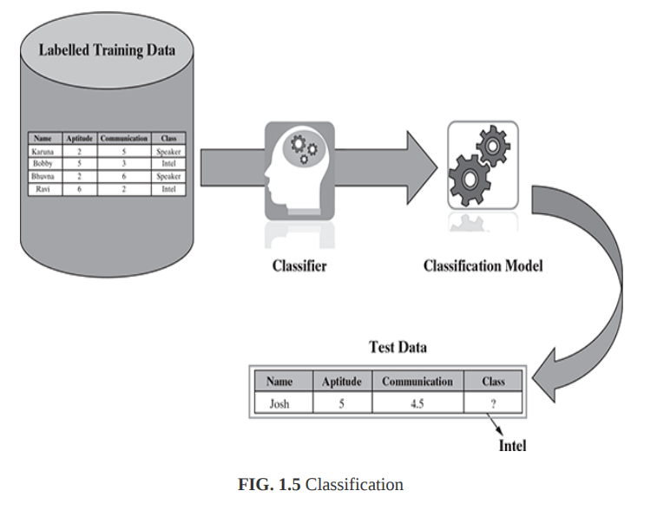
Classification Model
Classification
Classification is a supervised machine learning method. In Classification, a program learns from the given dataset or observations and then classifies new observation into a number of classes or groups. Such as, Yes or No, 0 or 1, Spam or Not Spam, cat or dog, etc. Classes can be called as targets/labels or categories.

Slide 65
Supervised Learning Algorithms
Some typical classification problems include:
Image classification
Prediction of disease
Win–loss prediction of games
Prediction of natural calamity like earthquake, flood, etc.
Recognition of handwriting

Slide 66
Supervised Learning- Classification Algorithms
  K-Nearest Neighbour
  Decision Tree
  Random Forest
  Support Vector Machine

Slide 67
K-Nearest Neighbour Classifier
The kNN algorithm is a simple but extremely powerful classification algorithm. The name of the algorithm originates from the underlying philosophy of kNN – i.e. people having similar background or mindset tend to stay close to each other.
The K-Nearest Neighbors (KNN) algorithm is a popular machine learning technique used for classification tasks. It relies on the idea that similar data points tend to have similar labels or values.
During the training phase, the KNN algorithm stores the entire training dataset as a reference.
When making predictions, it calculates the distance between the input data point and all the training examples, using a chosen distance metric such as Euclidean distance.

Slide 68


K-Nearest Neighbour Classifier
Next, the algorithm identifies the K nearest neighbors to the input data point based on their distances.
In the case of classification, the algorithm assigns the most common class label among the K neighbors as the predicted label for the input data point.
(Test Data) New Data Point
(Training Data) Existing Data Points

Slide 69

K-Nearest Neighbour Classifier
Finding the similarities as a measure of distance (Euclidean distance)
Identifying K nearest neighbors to the input data point based on their distances.

Slide 70

K-Nearest Neighbour Classifier
3. Assigns the most common class label among the K neighbors as the predicted label for the input data point.

Slide 71

K-Nearest Neighbour Classifier Algorithm

Slide 72
K-Nearest Neighbour Classifier Algorithm
Why the kNN algorithm is called a lazy learner?
It stores the training data and directly applies the philosophy of nearest neighborhood finding to arrive at the classification.
So, for kNN, there is no learning happening in the real sense.
Therefore, kNN falls under the category of lazy learner.

Slide 73



K-Nearest Neighbour Classifier Algorithm
Dataset: Iris

Slide 74


K-Nearest Neighbour Classifier

Slide 75

K-Nearest Neighbour Classifier

Slide 76

K-Nearest Neighbour Classifier
Setosa

Slide 77
K-Nearest Neighbour Classifier Algorithm
Few strategies, highlighted below, are adopted by machine
learning practitioners to arrive at a value for k.
One common practice is to set k equal to the square root of the number of training records.
An alternative approach is to test several k values on a variety of test data sets and choose the one that delivers the best performance.
Another interesting approach is to choose a larger value of k, but apply a weighted voting process in which the vote of close neighbours is considered more influential than the vote of distant neighbours.

Slide 78

Class room Assignment 1
Apply KNN Classifier to classify New Instance Height and Weight Example of following

Slide 79


Decision Tree Classification Algorithm
A Decision tree is a type of supervised learning algorithm that is commonly used in machine learning to model and predict outcomes based on input data.
Decision Tree is a Supervised learning technique that can be used for both classification and Regression problems, but mostly it is preferred for solving Classification problems.
It is a tree-structured classifier, where internal nodes represent the features of a dataset, branches represent the decision rules and each leaf node represents final result or the outcome.

Slide 80
Decision Tree Classification Algorithm
Decision Tree Terminologies
Root Node: Root node is from where the decision tree starts. It represents the entire dataset, which further gets divided into two or more homogeneous sets.
Leaf Node: Leaf nodes are the final output node, and the tree cannot be segregated further after getting a leaf node.
Splitting: Splitting is the process of dividing the decision node/root node into sub-nodes according to the given conditions.
Branch/Sub Tree: A tree formed by splitting the tree.
Pruning: Pruning is the process of removing the unwanted branches from the tree.
Parent/Child node: The root node of the tree is called the parent node, and other nodes are called the child nodes.

Slide 81


Decision Tree classification example
Sample Dataset
how to select the best attribute for the Root node and for sub-nodes ?

Slide 82
Decision Tree Classification Algorithm
Attribute Selection Measures:
While implementing a Decision tree, the main issue arises that how to select the best attribute for the root node and for sub-nodes. So, to solve such problems there is a technique which is called as Attribute selection measure or ASM.
By this measurement, we can easily select the best attribute for the nodes of the tree. There are two popular techniques for ASM, which are:
Information Gain
Gini Index

Slide 83

Decision Tree Classification Algorithm
Information Gain
Information gain will give maximum information out of available attributes of a dataset
Maximum information of a attribute is considered as ROOT NODE or Internal node (Splitting node)
A decision tree algorithm always tries to maximize the value of information gain, and a node/attribute having the highest information gain is split first.
Information gain is the measurement of changes in entropy after the segmentation or splitting of a dataset based on an attribute.
It calculates how much information a feature provides us about a class.
According to the value of information gain, we split the node and build the decision tree.
It can be calculated using the below formula:
$$Gain\left(S, A\right)≡Entropy\left(S\right)−\sum_{v∈Values\left(A\right)}{\frac{\left|S_{v}\right|}{\left|S\right|} }Entropy\left(S_{v}\right)$$

Slide 84


Decision Tree Classification Algorithm
Entropy
Entropy is a metric to measure the impurity in a given attribute. It specifies randomness in data. Entropy can be calculated as:
Entropy(s)= - P(+) $\log_{2}$P(+) - P(-) $\log_{2}$ P(-)
Entropy(s)= - P(yes) $\log_{2}$P(yes) - P(no) $\log_{2}$ P(no)
Here,
p₊ or P(yes) is the probability of positive class
p₋ or P(no) is the probability of negative class
S is the subset of the training example

Slide 85



How do Decision Trees use Entropy?
Entropy(s)= - P(yes) $\log_{2}$P(yes) - P(no) $\log_{2}$ P(no)
Entropy For feature 2,
Entropy For feature 3,
We can clearly see from the tree itself that left node has low entropy or more purity than right node

Slide 86


Slide 87

Example Problem
Calculation of Entropy of Outlook attribute values and
Calculation of Gain of Outlook attribute

Slide 88

Calculation of Entropy of Temperature attribute values and
Calculation Gain of Temperature attribute
Note: This is UNIT-1 Partial PPT….Complete one will be updated soon…

Slide 89

Note: This is UNIT-1 Partial PPT….Complete one will be updated soon…

Slide 90

Note: This is UNIT-1 Partial PPT….Complete one will be updated soon…

Slide 91


Comparing Gain of all attributes for Root node selection or Node splitting

Slide 92

Calculation of Gain of Left Internal node for Splitting

Slide 93


Slide 94


Slide 95


Slide 96



Slide 97

Calculation of Gain of Right Internal node for Splitting

Slide 98


Slide 99


Slide 100


Slide 101


Slide 102


FINAL DECISION TREE

Slide 103

Decision Tree Algorithm

Slide 104
2. Gini Index
The other way of splitting a decision tree is via the Gini Index. The Entropy and Information Gain method focuses on purity and impurity in a node.
It is the probability of misclassifying a randomly chosen element in a set.
Gini Index is a metric to measure how often a randomly chosen element would be incorrectly identified.
The Gini Index is a measure of the inequality or impurity of a distribution, commonly used in decision trees and other machine learning algorithms.
Gini Index or Gini impurity measures the probability for a random instance being misclassified when chosen randomly. The lower the Gini Index, the better the lower the likelihood of misclassification.
An attribute with a lower Gini index should be preferred.
A lower Gini Index indicates a more homogeneous or pure distribution, while a higher Gini Index indicates a more heterogeneous or impure distribution.
In decision trees, the Gini Index is used to evaluate the quality of a split by measuring the difference between the impurity of the parent node and the weighted impurity of the child nodes.

Slide 105

Where n represents the no. of classes in the target variable
P(i) represents the ratio of Class occurrence/Total no. of observations in node.
It is calculated by summing the squared probabilities of each outcome in a distribution and subtracting the result from 1.
Compared to other impurity measures like entropy, the Gini Index is faster to compute and more sensitive to changes in class probabilities.
In practice, the choice between using the Gini Index or other impurity measures depends on the specific problem and dataset, and often requires experimentation and tuning.

Slide 106


Entropy has a maximum impurity of 1 and maximum purity is 0.
Gini index has a maximum impurity is 0.5 and maximum purity is 0.
Different Decision Tree algorithms. For example, CART (Classification and Regression Trees) uses Gini; ID3 (Iterative Dichotomiser 3) and C4.5 use Entropy.

Slide 107
Decision Tree classification example Using GINI INDEX - CART
Sample Dataset
how to select the best attribute for the Root node and for sub-nodes ?

Slide 108
Decision Tree classification example Using GINI INDEX
Gini (S) = 1 - ((9/14)^2 + (5/14)^2) = 0.45
Gini (Sunny) = 1 - ((2/5)^2 + (3/5)^2) = 0.48
Gini (Overcast) = 1 - ((4/4)^2 + (0/4)^2) = 0
Gini (Rain) = 1 - ((3/5)^2 + (2/5)^2) = 0.48
Weighted Average (Outlook) =
w1* Gini (Sunny)+w2*Gini (Overcast) +w3*Gini (Rain)
Weighted Average (Outlook) =
5/14*0.48 + 4/14*0 + 5/14*0.48 = 0.029 (Gini Index)

Slide 109
Decision Tree classification example Using GINI INDEX
Note:
Continue the procedure of Gini Calculation for the other values of Outlook Attribute and calculate GINI INDEX for Outlook Attribute
Similarly Calculate GINI INDEX for other Attributes (Temp,Humidity and wind) after calculation of Gini for their individual values.
Consider the Attribute as ROOT NODE/Splitting node which is having the least GINI INDEX.
Continue the procedure until leaf nodes classifying the result

Slide 110

Decision Tree - Regressor

Slide 111

Decision Tree - Regressor

Slide 112

Decision Tree - Regressor

Slide 113

Decision Tree - Regressor

Slide 114

Decision Tree - Regressor

Slide 115

Decision Tree - Regressor

Slide 116

Decision Tree - Regressor

Slide 117

Decision Tree - Regressor

Slide 118

Decision Tree - Regressor

Slide 119

Decision Tree - Regressor

Slide 120

Decision Tree - Regressor

Slide 121

Decision Tree - Regressor

Slide 122

Decision Tree - Regressor

Slide 123

Decision Tree - Regressor

Slide 124
Decision Tree-Over-fitting Issue
Over-fitting:
  Too many branches, some may reflect anomalies due to noise or outliers
  Too much complexity
  Poor accuracy for unseen samples or Testing data
Two approaches to avoid overfitting
  Pruning
    Pre-pruning
    Post-pruning

Slide 125
Pruning
Pruning is a technique that reduces the size of a decision tree by removing branches of the tree which provide little predictive power
It is a regularization method that reduces the complexity of the final model, thus reducing overfitting
Decision trees are prone to overfitting!
Pruning methods:
Pre-pruning: Stop the tree building algorithm before it fully classifies the data
Post-pruning: Build the complete tree, then replace some non-leaf nodes with leaf nodes if this improves Testing error

Slide 126








Pre-pruning
Minimum threshold on entropy
𝜽_{𝒆𝒏𝒕} = 𝟎. 𝟒
Pre-pruning implies early stopping:
If some condition is met, the current node will not be split, even if it is not 100% pure
It will become a leaf node with the label of the majority class in the current set
Common stopping criteria include setting a threshold on:
Entropy (or Gini Impurity) of the current set
Gain of the best-splitting attribute
Depth of the tree
Number of samples in the current set
$$entropy(54|5)= 0.29 < θent$$
Stop, even if node can be split
91.52% confidence

Slide 127





Post-pruning
Prune nodes in a bottom-up manner, if it decreases validation error

Slide 128

Post-pruning
Prune nodes in a bottom-up manner, if it decreases validation error

Slide 129

Post-pruning
Prune nodes in a bottom-up manner, if it decreases validation error

Slide 130
Enhancements to Basic Decision Tree Induction
Allow for continuous-valued attributes
  Dynamically define new discrete-valued attributes that partition the continuous attribute value into a discrete set of intervals
Handle missing attribute values
  Assign the most common value of the attribute
  Assign probability to each of the possible values
Attribute construction
  Create new attributes based on existing ones that are sparsely represented
  This reduces fragmentation, repetition, and replication

Slide 131
Random Forest Model

Slide 132


Random Forest Model
The Random forest or Random Decision Forest is a supervised Machine learning algorithm used for classification, regression, and other tasks using decision trees.
  We can reduce the amount of overfitting issue of Decision Tree by majority voting and averaging their results of all decision trees in Random Forest
Random Forests are particularly well-suited for handling large and complex datasets, dealing with high-dimensional feature spaces, and providing insights into feature importance.

Slide 133
Random Forests Procedure
Random Forests:
Instead of building a single decision tree and use it to make predictions, build many slightly different trees and combine their predictions
We have a single data set, so how do we obtain slightly different trees?
1. Bagging (Bootstrap Aggregating):
Take random subsets of data points from the training set to create N smaller data sets
Fit a decision tree on each subset
2. Random Subspace Method (also known as Feature selection/Feature Bagging):
Fit N different decision trees by constraining each one to operate on a random subset of features

Slide 134
Bootstrap sample
  To build a tree first we need to take a bootstrap sample
    How?
      From our n_samples data points, we repeatedly draw an sample randomly with replacement n_samples times
      Replacement meaning the same sample can be picked multiple times
  Example on Boot Strap Sample -
    Creating a bootstrap sample of the list ['a', 'b', 'c', 'd'].
    A possible bootstrap sample would be ['b', 'd', 'd', 'c'].
    Another possible sample would be ['d', 'a', 'd', 'a’]
  This will create a dataset that is as big as the original dataset, but some data points will be missing from it , and some will be repeated

Slide 135

How to do Bootstrap -Example
      From our n_samples data points (whole datset) , we repeatedly draw an sample randomly with replacement n_samples times

Slide 136









Bagging at training time
N subsets (with replacement)
Training set

Slide 137









Bagging (Bootstrap Aggregating) at Testing/inference time
A test sample
75% confidence

Slide 138





































Random Subspace (Feature Bagging/Feature selection) Method at training time
Training data

Slide 139






Random Subspace (Feature Bagging/Feature selection) Method at testing time
A test sample
66% confidence

Slide 140



































Random Forests
Tree 1
Tree 2
Random Forest
Tree N

Slide 141
Random Forest Model
Random Forest Algorithm:
Step 1: Select random samples from a given data or training set.
Step 2: This algorithm will construct a decision tree for every training data.
Step 3: Voting will take place by averaging the decision tree.
Step 4: Finally, select the most voted prediction result as the final prediction result.

Slide 142

Random Subspace (Feature Bagging/Feature selection)–Example 2

Slide 143
Support Vector Machine (SVM)

Slide 144

Support Vector Machine (SVM)
Support Vector Machine or SVM is one of the most popular Supervised Learning algorithms, which is used for Classification as well as Regression problems. However, primarily, it is used for Classification problems in Machine Learning.
The goal of the SVM algorithm is to create the best line or decision boundary that can segregate n-dimensional space into classes so that we can easily put the new data point in the correct category in the future.
This best decision boundary is called a hyperplane.
SVM chooses the extreme points/vectors that help in creating the hyperplane. These extreme cases are called as support vectors, and hence algorithm is termed as Support Vector Machine. Consider the below diagram in which there are two different categories that are classified using a decision boundary or hyperplane:

Slide 145

Support Vector Machine (SVM)
Types of SVM
Linear SVM: Linear SVM is used for linearly separable data, which means if a dataset can be classified into two classes by using a single straight line, then such data is termed as linearly separable data, and classifier is used called as Linear SVM classifier.
Non-linear SVM: Non-Linear SVM is used for non-linearly separated data, which means if a dataset cannot be classified by using a straight line, then such data is termed as non-linear data and classifier used is called as Non-linear SVM classifier.

Slide 146


Support Vector Machines (SVM)
Hyper-plane in the SVM algorithm:
Hyperplane: There can be multiple lines/decision boundaries to segregate the classes in n-dimensional space, but we need to find out the best decision boundary that helps to classify the data points. This best boundary is known as the hyperplane of SVM.
The dimensions of the hyperplane depend on the features present in the dataset, which means if there are 2 features , then hyperplane will be a straight line. And if there are 3 or more features, then hyperplane will be a N-dimension plane etc..

Slide 147
Support Vector Machines (SVM)
Hyper-plane in the SVM algorithm:
Mathematically, a hyper-plane in an n-dimensional Euclidean space can be defined by a linear equation:
a₁x₁ + a₂x₂ + ... + a_{n}x_{n} = b
Here, x₁, x₂, ..., x_{n} are the coordinates in the n-dimensional space,
a₁, a₂, ..., a_{n} are the coefficients that determine the orientation of the hyperplane, and b is a constant term that determines the offset of the hyperplane from the origin.

Slide 148
Support Vector Machines (SVM)
Support Vectors in the SVM algorithm:
The data points or vectors that are the closest to the hyperplane and which affect the position of the hyperplane are termed as Support Vectors. Since these vectors support the hyperplane, hence called a Support vectors.

Slide 149

Support Vector Machines (SVM) :
How does SVM works?
Linear SVM:
The working of the SVM algorithm can be understood by using an example. Suppose we have a dataset that has two tags (green and blue), and the dataset has two features x1 and x2. We want a classifier that can classify the pair(x1, x2) of coordinates in either green or blue.

Slide 150

Support Vector Machines (SVM) :
So as it is 2-d space so by just using a straight line, we can easily separate these two classes. But there can be multiple lines that can separate these classes.
SVM algorithm finds the closest point of the lines from both the classes. These points are called support vectors.
Hence, the SVM algorithm helps to find the best line or decision boundary; this best boundary or region is called as a hyperplane.

Slide 151

Support Vector Machines (SVM)
The distance between the vectors and the hyperplane is called as margin.
We always create a hyperplane that has a maximum margin, which means the maximum distance between the data points.
The goal of SVM is to maximize this margin. The hyperplane with maximum margin is called the optimal hyperplane.

Slide 152


Support Vector Machine (SVM)
Non-Linear SVM:
If data is linearly arranged, then we can separate it by using a straight line, but for non-linear data, we cannot draw a single straight line.
So to separate these data points, we need to add one more dimension.
For linear data, we have used two dimensions x and y, so for non-linear data, we will add a third dimension z.
It can be calculated as: z=x² +y²

Slide 153

Support Vector Machines (SVM) :
So now, SVM will divide the datasets into classes in the following way.

Slide 154

Support Vector Machine (SVM)
Since we are in 3-d Space, hence it is looking like a plane parallel to the x-axis.
If we convert it in 2d space with z=1, then it will become as:
Hence we get a circumference of radius 1 in case of non-linear data.

Slide 155
Support Vector Machine (SVM)
SVM Kernel:
SVM algorithms use a set of mathematical functions that are defined as the kernel.
The function of kernel is to take data as input and transform it into the required form.
For example: The SVM kernel takes low-dimensional input space and transforms it into higher-dimensional space, ie it converts nonseparable problems to separable problems.
Different SVM algorithms use different types of kernel functions. These functions can be different types. For example linear, nonlinear, polynomial, radial basis function (RBF), and sigmoid etc.
Advantages of SVM:
Effective in high dimensional cases
Its memory efficient as it uses a subset of training points in the decision function called support vectors
Different kernel functions can be specified for the decision functions and its possible to specify custom kernels

Slide 156
Applications of SVM
Handwriting recognition – We use SVMs to recognize handwritten characters used widely.
Face detection – SVMc classify parts of the image as a face and non-face and create a square boundary around the face.
Text and hypertext categorization – SVMs allow Text and hypertext categorization for both inductive and transductive models. They use training data to classify documents into different categories. It categorizes on the basis of the score generated and then compares with the threshold value.
Classification of images – Use of SVMs provides better search accuracy for image classification. It provides better accuracy in comparison to the traditional query-based searching techniques.
Bioinformatics – It includes protein classification and cancer classification. We use SVM for identifying the classification of genes, patients on the basis of genes and other biological problems.
Protein fold and remote homology detection – Apply SVM algorithms for protein remote homology detection.

Slide 157
Content beyond the Syllabus

Slide 158
Bias and Variance in Machine Learning
1.Bias: It is the error due to the model’s inability to represent the true relationship between input and output accurately.
When a model has poor performance both on the training and testing data means high bias because of the simple model, indicating under-fitting.
Bias refers to the error due to overly simplistic assumptions in the learning algorithm. These assumptions make the model easier to comprehend and learn but might not capture the underlying complexities of the data.
2.Variance: is the error that occurs due to sensitivity to small changes in the training set.
It’s the variability of the model’s predictions for different instances of training data.
High variance occurs when a model learns the training data’s noise and random fluctuations rather than the underlying pattern. As a result, the model performs well on the training data but poorly on the testing data, indicating overfitting.

Slide 159


Under-fitting vs Over-fitting
High bias & Low variance
Low Bias & Low variance
Low Bias
High variance
Reasons for Under-fitting:
The size of the training dataset used is not enough.
The model is too simple, So it may be not capable to represent the complexities in the data.
The input features which is used to train the model is not the adequate representations of underlying factors influencing the target variable.
Excessive regularization are used to prevent the overfitting, which constraint the model to capture the data well.

Slide 160
Under-fitting vs Over-fitting
High bias & Low variance
Low Bias & Low variance
Low Bias
High variance
Reasons for Over-fitting:
The model is too complex.
Too many Parameters and Rules
The fluctuations or changes in the training data
High variance and low bias.

Slide 161

High Bias vs High Variance

Slide 162

Comparison
Low-Bias, Low-Variance:
The combination of low bias and low variance shows an ideal machine learning model. Best fit model
Low-Bias, High-Variance: With low bias and high variance, model predictions are inconsistent and accurate on average. This case occurs when the model learns with a large number of parameters and hence leads to an overfitting
High-Bias, Low-Variance: With High bias and low variance, predictions are consistent but inaccurate on average. This case occurs when a model does not learn well with the training dataset or uses few numbers of the parameter. It leads to underfitting problems in the model.
High-Bias, High-Variance:
With high bias and high variance, predictions are inconsistent and also inaccurate on average.

Slide 163
CONFUSION MATRIX

Slide 164
CONFUSION MATRIX
Metric is a technique to evaluate the performance of the model.
List of various metric we will be covering in this blog.
Accuracy
Null Accuracy
Precision
Recall
f1 score
ROC — AUC
Accuracy : This is the most naive and commonly used metric in the context of classification. It is just the mean of correct predictions.

Slide 165
CONFUSION MATRIX
A Confusion matrix or error matrix is used for summarizing the performance of a classification algorithm
Confusion matrix is used to find the accuracy of the classification model or a classifier.
It will be applied on classification problems rather than regression.
The given data set is divided into two ways
1. Training data (80%) ---- Model can be build on training data
2. Test Data (20%) ------ Accuracy of a model will be calculated using test data.
To find the accuracy of a given model confusion matrix will be used.
Calculating a confusion matrix can give you an idea of where the classification model is right and what types of errors it is making.
A confusion matrix is used to check the performance of a classification model on a set of test data for which the true values are known.
Performance measures such as precision, recall are calculated from the confusion matrix.

Slide 166
How To Use Confusion Matrix:
Confusion matrix is always a square matrix.
For example
If the number of categories of target variable is 2 then we get confusion matrix order is 2 i.e 2 x2 .
In general, if the order confusion matrix is n x n where n is the number of categories in target variable.
S.NO | PATEINT NAME | AGE | ACTUAL VALUE (DIABITIES) | PREDICTED VALUE
1 | A | 45 | YES | YES
2 | B | 50 | NO | YES
3 | C | 57 | YES | NO
4 | D | 68 | YES | YES
5 | E | 30 | NO | NO
6 | F | 76 | NO | YES

Slide 167

CONFUSION MATRIX
A confusion matrix provides a summary of the predictive results in a classification problem.
Correct and incorrect predictions are summarized in a table with their values and broken down by each class.
Fig: Confusion Matrix for the Binary Classification
Remember, we describe predicted values as Positive/Negative and
Actual values as True/False.

Slide 168
CONFUSION MATRIX
We can not rely on a single value of accuracy in classification when the classes are imbalanced.
For example, we have a dataset of 100 patients in which 5 have diabetes and 95 are healthy.
However, if our model only predicts the majority class i.e. all 100 people are healthy even though we have a classification accuracy of 95%. Therefore, we need a confusion matrix.
Calculate A Confusion Matrix for 2x2 :
We have a total of 10 cats and dogs and our model predicts whether it is a cat or not.
Actual values = [‘dog’, ‘cat’, ‘dog’, ‘cat’, ‘dog’, ‘dog’, ‘cat’, ‘dog’, ‘cat’, ‘dog’]
Predicted values = [‘dog’, ‘dog’, ‘dog’, ‘cat’, ‘dog’, ‘dog’, ‘cat’, ‘cat’, ‘cat’, ‘cat’]

Slide 169

CONFUSION MATRIX
Remember, we describe predicted values as Positive/Negative and
Actual values as True/False.

Slide 170
CONFUSION MATRIX
Definition of the Terms:
True Positive: You predicted positive and it’s true. You predicted that an animal is a cat and it actually is.
True Negative: You predicted negative and it’s true. You predicted that animal is not a cat and it actually is not (it’s a dog).
False Positive (Type 1 Error): You predicted positive and it’s false. You predicted that animal is a cat but it actually is not (it’s a dog).
False Negative (Type 2 Error): You predicted negative and it’s false. You predicted that animal is not a cat but it actually is.
A confusion matrix is used to check the performance of a classification model on a set of test data for which the true values are known.
Most performance measures such as precision, recall are calculated from the confusion matrix.

Slide 171


CONFUSION MATRIX
Recall (aka Sensitivity)
Recall is defined as the ratio of the total number of correctly classified positive classes divide by the total number of positive classes. Or, out of all the positive classes, how much we have predicted correctly. Recall should be high.
Precision is defined as the ratio of the total number of correctly classified positive classes divided by the total number of predicted positive classes. Or, out of all the predictive positive classes, how much we predicted correctly. Precision should be high.

Slide 172


CONFUSION MATRIX
Classification Accuracy:
Classification Accuracy is given by the relation:
F-score or F1-score:
It is difficult to compare two models with different Precision and Recall. So to make them comparable, we use F-Score. It is the Harmonic Mean of Precision and Recall. As compared to Arithmetic Mean, Harmonic Mean punishes the extreme values more. F-score should be high.

Slide 173

CONFUSION MATRIX
Specificity:
Specificity determines the proportion of actual negatives that are correctly identified.
Example to interpret confusion matrix:
Let’s calculate confusion matrix using above cat and dog example:

Slide 175

CONFUSION MATRIX

Slide 176
CONFUSION MATRIX
Classification Accuracy:
Accuracy = (TP + TN) / (TP + TN + FP + FN) = (3+4)/(3+4+2+1) = 0.70
Recall: Recall gives us an idea about when it’s actually yes, how often does it predict yes.
Recall = TP / (TP + FN) = 3/(3+1) = 0.75
Precision: Precision tells us about when it predicts yes, how often is it correct.
Precision = TP / (TP + FP) = 3/(3+2) = 0.60
F-score:
F-score = (2*Recall*Precision)/(Recall + Precision) = (2*0.75*0.60)/(0.75+0.60) = 0.67
Specificity:
Specificity = TN / (TN + FP) = 4/(4+2) = 0.67

Slide 177
CONFUSION MATRIX
Summary:
Precision is how certain you are of your true positives. Recall is how certain you are that you are not missing any positives.
Choose Recall if the occurrence of false negatives is unaccepted/intolerable. For example, in the case of diabetes that you would rather have some extra false positives (false alarms) over saving some false negatives.
Choose Precision if you want to be more confident of your true positives. For example, in case of spam emails, you would rather have some spam emails in your inbox rather than some regular emails in your spam box. You would like to be extra sure that email X is spam before we put it in the spam box.
Choose Specificity if you want to cover all true negatives, i.e. meaning we do not want any false alarms or false positives. For example, in case of a drug test in which all people who test positive will immediately go to jail, you would not want anyone drug-free going to jail.

Slide 178
CONFUSION MATRIX
We can conclude that:
Accuracy value of 70% means that identification of 3 of every 10 cats is incorrect, and 7 is correct.
Precision value of 60% means that label of 4 of every 10 cats is a not a cat (i.e. a dog), and 6 are cats.
Recall value is 70% means that 3 of every 10 cats, in reality, are missed by our model and 7 are correctly identified as cats.
Specificity value is 60% means that 4 of every 10 dogs (i.e. not cat) in reality are miss-labeled as cats and 6 are correctly labeled as dogs.

Slide 179
CONFUSION MATRIX FOR 3 X 3
Consider the following clusters:
1. TP = True positives = Actual C1 is predicted as C1+
Actual C2 is predicted as C2+
Actual C3 is predicted as C3
= 2+2+2 = 6
 | C1 | C2 | C3
C1 | 2 | 1 | 0
C2 | 1 | 2 | 0
C3 | 0 | 0 | 2
PREDICTED VALUES
ACUAL VALUES

Slide 180

CONFUSION MATRIX FOR 3 X 3
Consider the following clusters:
2. TN = True negatives = actual non C1 is predicted as non C1 +
actual non C2 is predicted as non C2 +
actual non C3 is predicted as non C3
= 4+4+6
= 14
 | C1 | C2 | C3
C1 | 2 | 1 | 0
C2 | 1 | 2 | 0
C3 | 0 | 0 | 2
PREDICTED VALUES
ACUAL VALUES

Slide 181
CONFUSION MATRIX FOR 3 X 3
Consider the following clusters:
3. FP = False positives = Actual non C1 is predicted as C1 +
Actual non C2 is predicted as C2 +
Actual non C3 is predicted as C3 +
= 1+1+0 = 2
 | C1 | C2 | C3
C1 | 2 | 1 | 0
C2 | 1 | 2 | 0
C3 | 0 | 0 | 2
PREDICTED VALUES
ACUAL VALUES

Slide 182
CONFUSION MATRIX FOR 3 X 3
Consider the following clusters:
4. FN = False Negative = Actual C1 is predicted as non C1 +
Actual C2 is predicted as non C2 +
Actual C3 is predicted as non C3 +
=1+1+0 = 2
 | C1 | C2 | C3
C1 | 2 | 1 | 0
C2 | 1 | 2 | 0
C3 | 0 | 0 | 2
PREDICTED VALUES
ACUAL VALUES

Slide 183


CONFUSION MATRIX
We can conclude that:
Accuracy = (TP+TN) / (TP+FP+FN+TN) = (6+14 ) / (6+14+2+2) = 0.833
Precision = TP/ (TP+FP) = 6/ (6+2) = 0.75.
Recall = TP / (TP+FN) = 6/ (6+2) = 0.75
F-measure = (2*P*R)/(P+R) =( 2* 0.75 * 0.75)/(0.75 + 0.75) = 0.75.
Purity: Sum of correctly assigned objects and dividing by N(total number of objects).

Slide 184

StandardScaler
One of the most commonly used feature scaling techniques is StandardScaler. It scales the data such that the mean is 0 and the standard deviation is 1. This means that the scaled data will have a normal distribution with a mean of 0 and a standard deviation of 1

Slide 185

How to transform/scaling a new data feature using standard scaler

